Slide 1

OBJECT ORIENTED MODELLING & DESIGN (OOMD)
SOFTWARE TESTING
UE19CS400SB
Prof. Venkatesh Prasad/Ms. Sumy Joseph
venkateshprasad@pes.edu
Department of Computer Science

Slide 2
MODULE 2: UNIT and INTEGRATION TESTING
Definition
Test Planning
Methodology
White Box Testing

Slide 3
Unit Testing
Unit testing is a software development process in which the smallest testable parts of an application, called units, are individually and independently scrutinized for proper operation.
Done during the development (coding phase) of an application by the developers.
A unit may be an individual function, method, procedure, module, or object.
Unit testing is first level of testing done before integration testing.
White Box testing technique that is usually performed by the developer.

Slide 4
Unit Testing
Acceptance Testing
Unit tests help to fix bugs early in the development cycle and save costs.
It helps the developers to understand the testing code base and enables them to make changes quickly
Good unit tests serve as project documentation
Unit tests help with code re-use. Migrate both your code and your tests to your new project.
System Testing
Integration Testing
Unit Testing

Slide 5
Unit Testing is of two types
Manual
A manual approach to unit testing may employ a step-by-step instructional document.
Automated
A developer writes a section of code in the application just to test the function.
A developer could also isolate the function to test it more rigorously. This is a more thorough unit testing practice that involves copy and paste of code to its own testing environment than its natural environment.
Isolating the code helps in revealing unnecessary dependencies between the code being tested and other units or data spaces in the product. These dependencies can then be eliminated.
A coder generally uses a UnitTest Framework to develop automated test cases. Using an automation framework, the developer codes criteria into the test to verify the correctness of the code. During execution of the test cases, the framework logs failing test cases.
The workflow of Unit Testing is 1) Create Test Cases 2) Review/Rework 3) Baseline 4) Execute Test Cases.

Slide 6
Unit Testing Tools
There are several automated unit test software available to assist with unit testing.
Junit: Junit is a free to use testing tool used for Java programming language. It provides assertions to identify test method. This tool test data first and then inserted in the piece of code.
NUnit: NUnit is widely used unit-testing framework use for all .net languages. It is an open source tool which allows writing scripts manually.
JMockit: JMockit is open source Unit testing tool. It is a code coverage tool with line and path metrics. It allows mocking API with recording and verification syntax. This tool offers Line coverage, Path Coverage, and Data Coverage.
EMMA: EMMA is an open-source toolkit for analyzing and reporting code written in Java language. Emma support coverage types like method, line, basic block. It is Java-based so it is without external library dependencies and can access the source code.
PHPUnit: PHPUnit is a unit testing tool for PHP programmer. It takes small portions of code which is called units and test each of them separately. The tool also allows developers to use pre-define assertion methods to assert that a system behave in a certain manner.

Slide 7
Unit Testing Techniques
Categorized into three parts
White box testing - that involves testing the functional behaviour of the software application
Black box testing - that involves testing of user interface along with input and output
Gray box testing - that is used to execute test suites, test methods, test cases and performing risk analysis.

Slide 8
WHITE BOX TESTING
White box testing techniques analyze the internal structures the used data structures, internal design, code structure and the working of the software rather than just the functionality as in black box testing.
Working process of white box testing:
Input: Requirements, Functional specifications, design documents, source code.
Processing: Performing risk analysis for guiding through the entire process.
Proper test planning: Designing test cases so as to cover entire code. Execute rinse-repeat until error-free software is reached. Also, the results are communicated.
Output: Preparing final report of the entire testing process.

Slide 9
White Box Testing Techniques
Techniques, Inspections, Coverage, complexity
Tools
Static Testing
Static Testing by Humans
Static Analysis Tools
Structural Testing
Code Coverage Testing
Code Complexity Testing

Slide 10
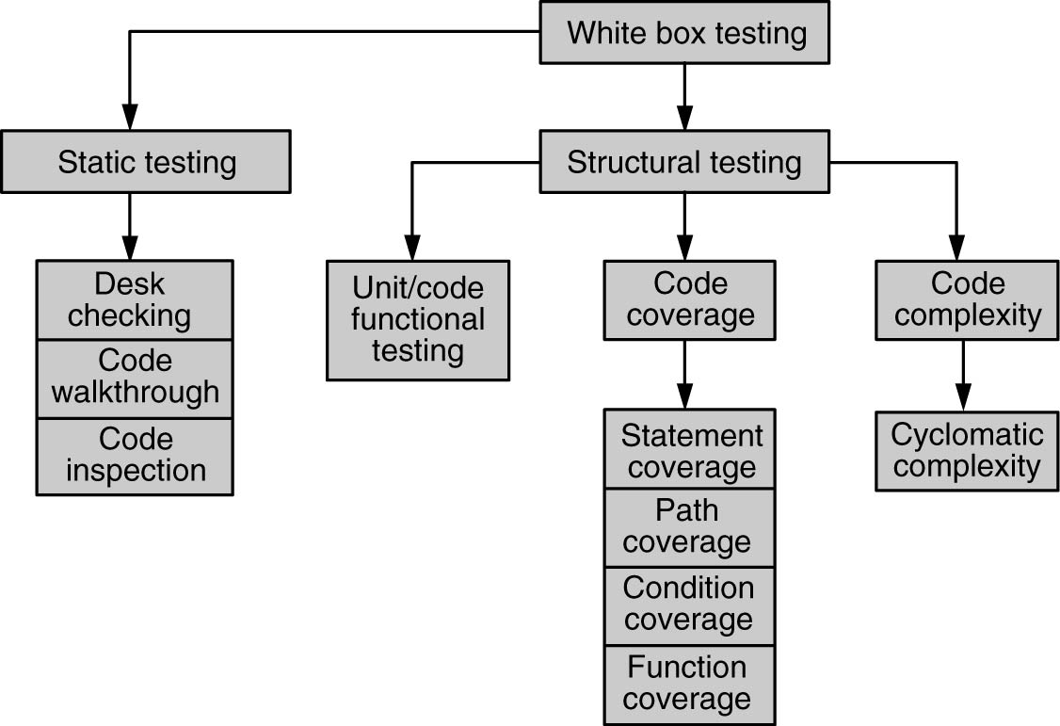
White Box Testing

Slide 11
White Box Testing-Static Testing
Static Testing by Humans
Desk Checking of the Code
Code Walkthrough
Formal Inspection

Slide 12
Static Testing
Static testing is a verification process used to test the application without implementing the code of the application. And it is a cost-effective process.
Why do we need to perform Static Testing?
We can use static testing to improve the development productivity.
If we performed static testing on an application, we could find the detects in the earlier stages and easily fix them.
The usage of static testing will decrease the testing cost, development timescales, and time.

Slide 13
Desk Checking of the Code
Desk checking is a similar process to proofreading; in this exercise, the programmer runs through lines of code to identify errors and to check logic.
Typically, the programmer will print out the code and go through it in a pencil and paper exercise. He may run a manual test on algorithms, checking that they work correctly and contain no coding errors.
This usually involves creating a table with columns containing line numbers, variables, conditions, and inputs and outputs, depending on the checks he is making.

Slide 14
Code Walkthrough
Code Walkthrough is a form of peer review in which a programmer leads the review process and the other team members ask questions and spot possible errors against development standards and other issues.
The meeting is usually led by the author of the document under review and attended by other members of the team.
Review sessions may be formal or informal.
Before the walkthrough meeting, the preparation by reviewers and then a review report with a list of findings.
The scribe, who is not the author, marks the minutes of meeting and note down all the defects/issues so that it can be tracked to closure.
The main purpose of walkthrough is to enable learning about the content of the document under review to help team members gain an understanding of the content of the document and also to find defects.

Slide 15
Code Inspection-Fagan Inspection
Demanding thorough preparation before an inspection/review
Enlisting multiple diverse view
Assigning specific roles to the multiple participants
Going sequentially thorough the code in a structured manner
Author
Moderator
Inspector
Scribe

Slide 16
Static Analysis Tools

Slide 17
Static Analysis Tools
Static analysis tools are generally used by developers as part of the development and component testing process.
The key aspect is that the code (or other artefact) is not executed or run but the tool itself is executed, and the source code we are interested in is the input data to the tool.
SonarQube is an open-source platform developed by SonarSource for continuous inspection of code quality.
Sonar does static code analysis, which provides a detailed report of bugs, code smells, vulnerabilities, code duplications.
The important thing is that the code (or other devices) isn’t running or executed, but the tool itself will be executed and that the source code we want is the input data for the tool.
https://www.educba.com/static-analysis-tools/

Slide 18
Test Driven Development - TDD
A new testing technique by advocates of Extreme Programming.
Introduction to TDD : “Test-Driven Development” by Kent Beck.
Two simple rules
Write a failing automated test before writing any code
Remove duplicates

Slide 19
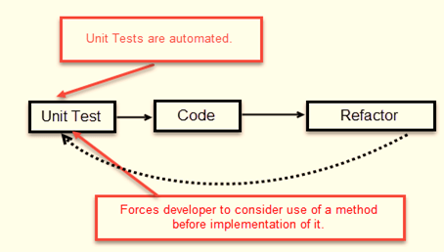
TDD process

Slide 20
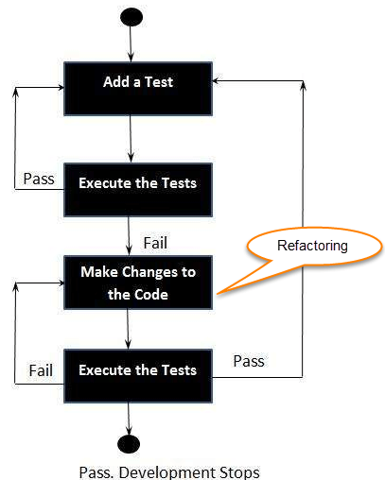
Steps in TDD

Slide 21
TDD advantages
It promotes affirmative testing of the application and it's specifications.
TDD makes code simpler and clear.
Reduces the documentation process at developers end.

Slide 22
Unit Testing Checklist
Write unit tests for all code
Don’t postpone the tests
Ensure that the code passes unit tests and integration tests before check-ins
Use automated tools such as NUnit
Check the tests and any other setup files into SCC
Consider using TDD for 100% coverage
Refactor code only when there are thorough set of tests for the code

Slide 23
STRUCTURAL TESTING
CODE COVERAGE TESTING
CODE COMPLEXITY TESTING

Slide 24
CODE COVERAGE TESTING-TYPES
STATEMENT COVERAGE
PATH COVERAGE
CONDITION COVERAGE
FUNCTION COVERAGE

Slide 25
Code Coverage Testing
Code Coverage testing is determining how much code is being tested. It can be calculated using the formula:
How is code coverage calculated?
Function coverage: how many of the functions defined have been called.
Statement coverage: how many of the statements in the program have been executed.
Branches coverage: how many of the branches of the control structures (if statements for instance) have been executed.
Condition coverage: how many of the boolean sub-expressions have been tested for a true and a false value.
Line coverage: how many of lines of source code have been tested.
https://www.guru99.com/code-coverage.html
Code Coverage = (Number of lines of code exercised)/(Total Number of lines of code) * 100%

Slide 26
Statement Coverage
This technique involves execution of all statements of the source code at least once.
It is used to calculate the total number of executed statements in the source code out of total statements present in the source code.
Statement coverage derives scenario of test cases under the white box testing process which is based upon the structure of the code.

Slide 27
Source Code Structure
Take input of two values like a=0 and b=1.
Find the sum of these two values.
If the sum is greater than 0, then print "This is the positive result."
If the sum is less than 0, then print "This is the negative result."
nput (int a, int b)
{
Function to print sum of these integer values (sum = a+b)
If (sum>0)
{
Print (This is positive result)
} else
{
Print (This is negative result)
}
}

Slide 28
Scenario1:
If a = 5, b = 4
print (int a, int b) {
int sum = a+b;
if (sum>0)
print ("This is a positive result")
else
print ("This is negative result")
}

Slide 29
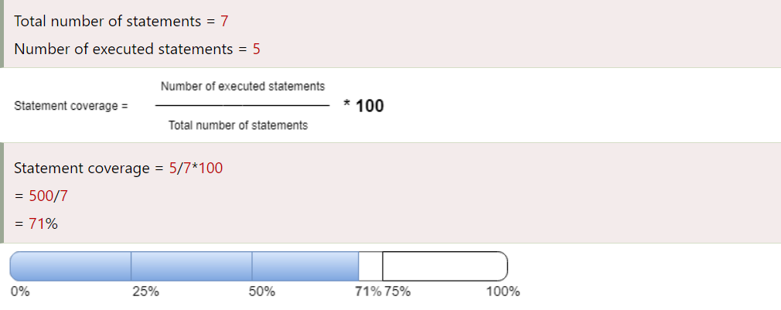
To calculate statement coverage of the first scenario, take the total number of statements that is 7 and the number of used statements that is 5.
Total number of statements = 7
Number of executed statements = 5

Slide 30
Scenario 2 : If A = -2, B = -7
print (int a, int b) {
int sum = a+b;
if (sum>0)
print ("This is a positive result")
else
print ("This is negative result")
}

Slide 31
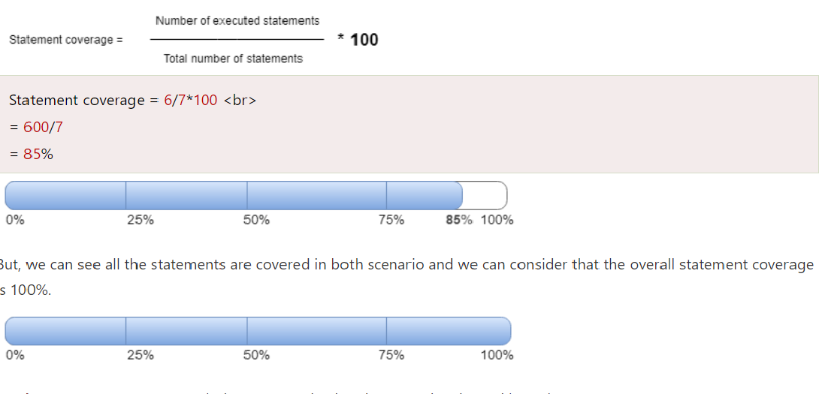
To calculate statement coverage of the first scenario, take the total number of statements that is 7 and the number of used statements that is 6.
Totalnumberofstatements=7 Number of executed statements = 6

Slide 32
Path Coverage
Path Coverage testing is a structured testing technique for designing test cases with intention to examine all possible paths of execution at least once.
Creating and executing tests for all possible paths results in 100% statement coverage and 100% branch coverage.
In this type of testing every statement in the program is guaranteed to be executed at least one time. Flow Graph, Cyclomatic Complexity are used to arrive at basis path
Advantages of Path Testing:
Path Testing helps reducing redundant tests
Focus on program logic
Test cases will execute every statement in a program at least once

Slide 33
Example of Path Coverage Testing
Read A Read B IF A+B > 50 THEN Print "Large" ENDIF If A+B<50 THEN Print "Small" ENDIF

Slide 34
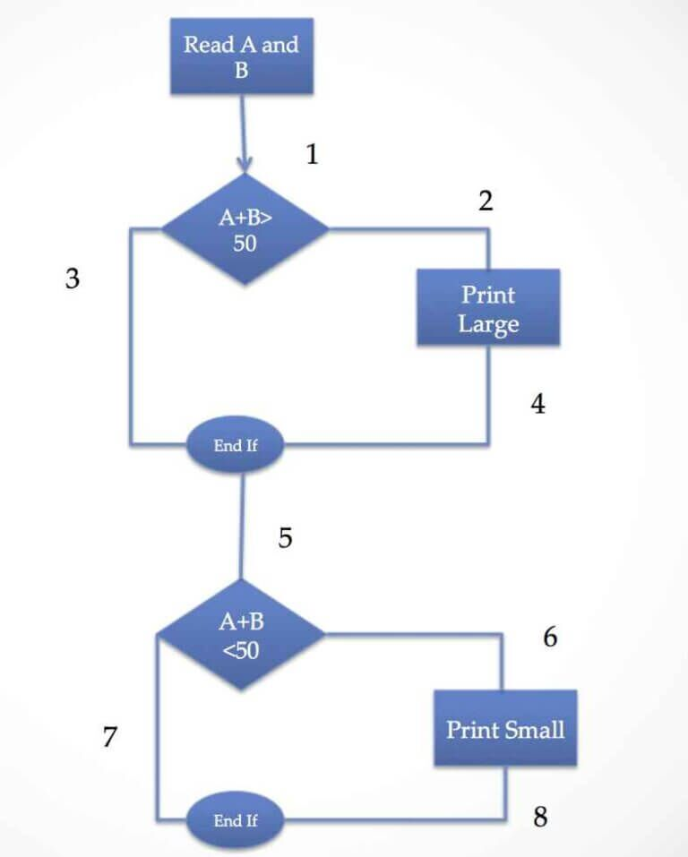

Slide 35
Path Coverage
Path Coverage ensures covering of all the paths from start to end.
All possible paths are-
1-3-5-7
1-3-5-6-8
1-2-4-5-6-8
1-2-4-5-7
So Path Coverage is 4.

Slide 36
Conditional Coverage
Condition coverage is also known as Predicate Coverage in which each one of the Boolean expression have been evaluated to both TRUE and FALSE.
Example
if ((A || B) && C)
{
<< Few Statements >>
}
else
{
<< Few Statements >>
}

Slide 37
Result
In order to ensure complete Condition coverage criteria for the above example, A, B and C should be evaluated at least once against "true" and "false".
So, in our example, the 3 following tests would be sufficient for 100% Condition coverage testing.
A = true | B = not eval | C = false
A = false | B = true | C = true
A = false | B = false | C = not eval

Slide 38
Function Coverage
This methodology measures the extent to which the functions present in source code are covered during testing.
All functions that are in the source code get tested during test execution.
In a source code there may be multiple functions and depending on the input values used a function may or may not be called.
Thus the purpose of Function Coverage is to ensure that we have each function called for.

Slide 39
CODE COMPLEXITY TESTING
CYCLOMATIC COMPLEXITY

Slide 40
CODE COMPLEXITY TESTING
Cyclomatic complexity of a code section is the quantitative measure of the number of linearly independent paths in it.
It is a software metric used to indicate the complexity of a program.
It is computed using the Control Flow Graph of the program.
The nodes in the graph indicate the smallest group of commands of a program, and a directed edge in it connects the two nodes i.e. if second command might immediately follow the first command.

Slide 41
CODE COMPLEXITY TESTING
M = E – N + 2P
where, E = the number of edges in the control flow graph N = the number of nodes in the control flow graph P = the number of connected components
Steps that should be followed in calculating cyclomatic complexity and test cases design are:
Construction of graph with nodes and edges from code.
Identification of independent paths.
Cyclomatic Complexity Calculation
Design of Test Cases

Slide 42
A = 10
IF B > C THEN
A = B
ELSE
A = C
ENDIF
Print A
Print B
Print C

Slide 43
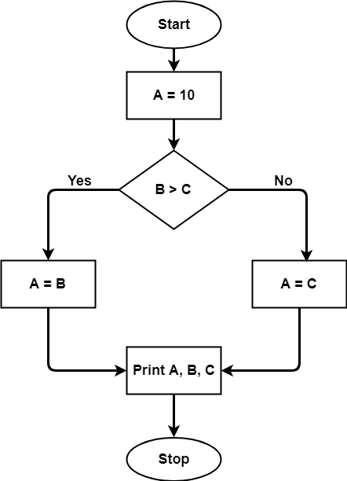

Slide 44
The cyclomatic complexity calculated for above code will be from control flow graph.
The graph shows seven shapes(nodes), seven lines(edges), hence cyclomatic complexity is 7-7+2 = 2.

Slide 45
CODE FREEZE????

Slide 46
INTEGRATION TESTING
TOP DOWN INTEGRATION
BOTTOM UP INTEGRATION
BIDIRECTIONAL INTEGRATION(HYBRID)
SYSTEM INTEGRATION

Slide 47
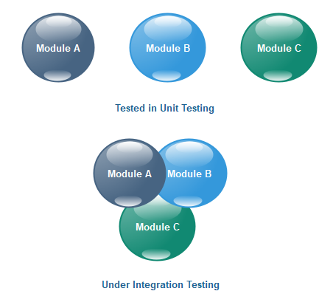
INTEGRATION TESTING
Integration testing is the second level of the software testing process comes after unit testing.
In this testing, units or individual components of the software are tested in a group.
The focus of the integration testing level is to expose defects at the time of interaction between integrated components or units.

Slide 48
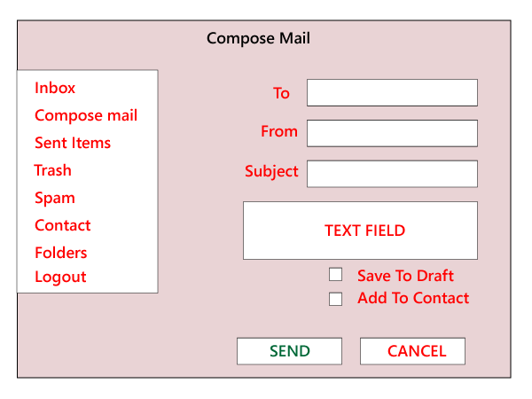
INTEGRATION TESTING-GMAIL :

Slide 49
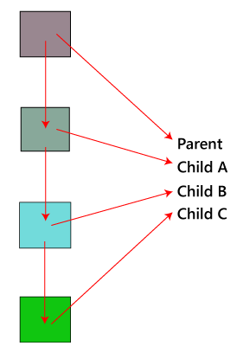
TOP DOWN INTEGRATION
The top-down testing strategy deals with the process in which higher level modules are tested with lower level modules until the successful completion of testing of all the modules.
Major design flaws can be detected and fixed early because critical modules tested first.
In this type of method, we will add the modules incrementally or one by one and check the data flow in the same order.

Slide 50
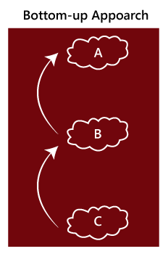
BOTTOM UP INTEGRATION
The top-down testing strategy deals with the process in which higher level modules are tested with lower level modules until the successful completion of testing of all the modules.
Major design flaws can be detected and fixed early because critical modules tested first.
In this type of method, we will add the modules incrementally or one by one and check the data flow in the same order.

Slide 51
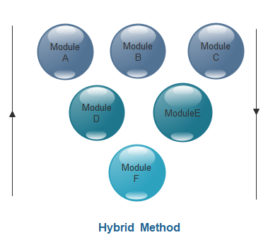
BIDIRECTIONAL INTEGRATION

Slide 52
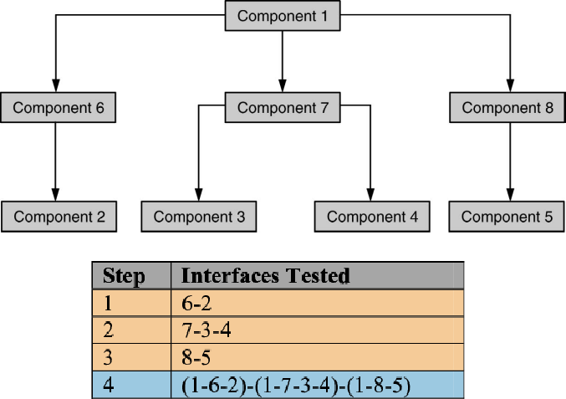
BI-DIRECTIONAL INTEGRATION

Slide 53
BI-DIRECTIONAL INTEGRATION
Combination of Top-down & Bottom up.
Individual components are separately tested.
Bi-Direction integration is done with use of Drivers & Stubs.
Drive - Upstream connectivity.
Stubs - Downstream connectivity.
Drivers & stubs are discarded after integration testing.
Sandwich Integration - is the combination of bottom-up approach and top-down approach, so it uses the advantage of both bottom up approach and top down approach. Initially it uses the stubs and drivers where stubs simulate the behaviour ogf missing component.

Slide 54
WHAT IS SCENARIO TESTING ?
Scenario Testing in software testing is a method in which actual scenarios are used for testing the software application instead of test cases.
The purpose of scenario testing is to test end to end scenarios for a specific complex problem of the software.
Scenarios help in an easier way to test and evaluate end to end complicated problems.
A Test Scenario is defined as any functionality that can be tested. It is also called Test Condition or Test Possibility.
As a tester, you should put yourself in the end user’s shoes and figure out the real-world scenarios and use cases of the Application Under Test.

Slide 55
Why create Test Scenarios?
Test Scenarios are created for the following reasons,
Creating Test Scenarios ensures complete Test Coverage
Test Scenarios can be approved by various stakeholders like Business Analyst, Developers, Customers to ensure the Application Under Test is thoroughly tested. It ensures that the software is working for the most common use cases.
They serve as a quick tool to determine the testing work effort and accordingly create a proposal for the client or organize the workforce.
They help determine the most important end-to-end transactions or the real use of the software applications.
For studying the end-to-end functioning of the program, Test Scenario is critical.

Slide 56
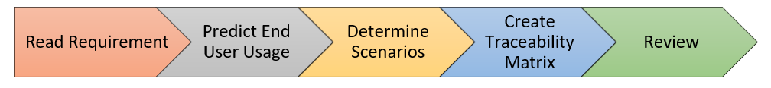
How to Write Test Scenarios
Step 1: Read the Requirement Documents like BRS, SRS, FRS, of the System Under Test (SUT).
Step 2: For each requirement, figure out possible users actions and objectives. Determine the technical aspects of the requirement.
Step 3: After reading the Requirements Document and doing your due Analysis, list out different test scenarios that verify each feature of the software.
Step 4: Once you have listed all possible Test Scenarios, a Traceability Matrix is created to verify that each & every requirement has a corresponding Test Scenario
Step 5: The scenarios created are reviewed by your supervisor. Later, they are also reviewed by other Stakeholders in the project.

Slide 57
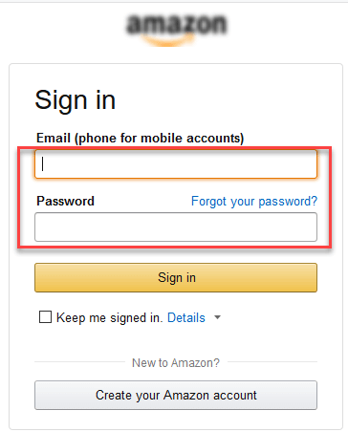
Example 1: Test Scenario for eCommerce Application
Test Scenario 1: Check the Login Functionality

Slide 58

Test Scenario 2: Check the Search Functionality

Slide 59

Test Scenario 3: Check the Product Description Page

Slide 60
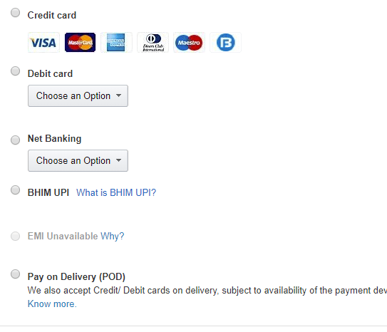
Test Scenario 4: Check the Payments Functionality

Slide 61
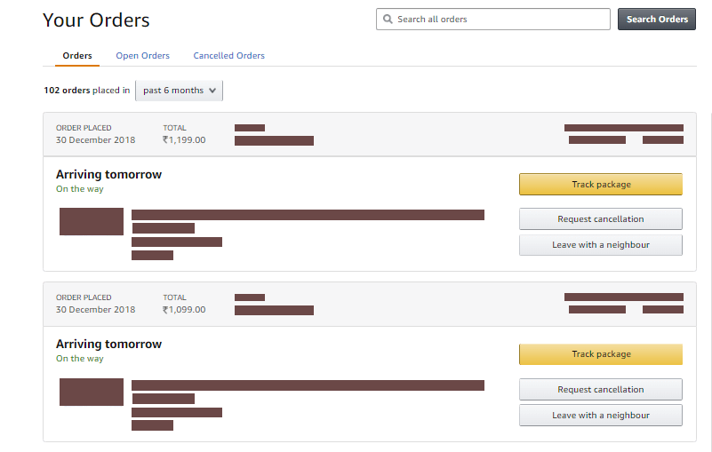
Test Scenario 5: Check the Order History

Slide 62
Other Scenarios….
Check Home Page behavior for returning customers
Check Category/Product Pages
Check Customer Service/Contact Pages
Check Daily Deals pages

Slide 63
Example 2: Test Scenarios for a Banking Site
Test Scenario 1: Check the Login and Authentication Functionality
Test Scenario 2: Check Money Transfer can be done
Test Scenario 3: Check Account Statement can be viewed
Test Scenario 4: Check Fixed Deposit/Recurring Deposit can be created

Slide 64
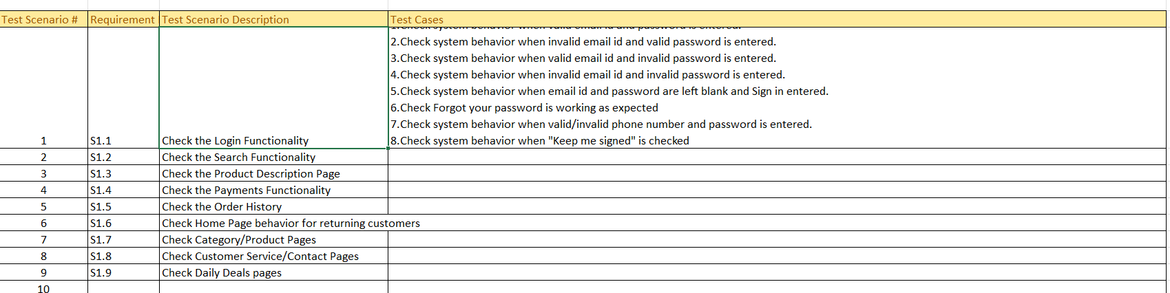
Test Scenario Template

Slide 65
Methods in Scenario Testing:
SYSTEM SCENARIOS
USE CASE SCENARIOS

Slide 66
SYSTEM SCENARIOS

Slide 67
USECASE SCENARIOS

